Slide 1
Fraser put the round number in.
Round X– The anti-film round? (Anti-filmrunden)
Maybe film round is a slightly misleading title...

Slide 2
Instructions (Instruktioner)
For each question we will show you two names. One is the name of the Ikea product shown.
The other is the name of a film nominated for the Nordic Council Film Prize.
All you have to do is
pick the name of the product for the point.
Fraser will read all of the options to be clear.¹
¹The author would like to apologise to all Nordic countries for the pronounciation which is about to occur.

Slide 3
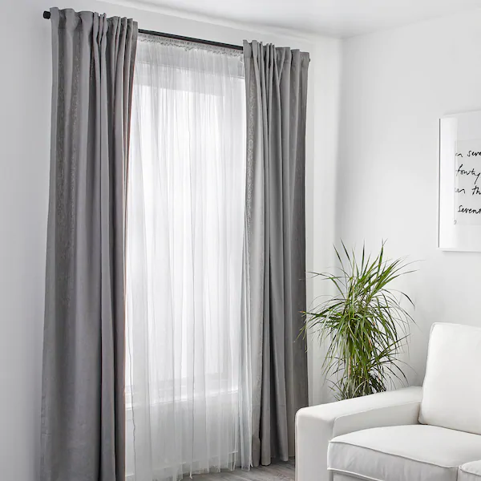
1. What are these? (Hvad er disse?)
Lill
Blindsone

Slide 4
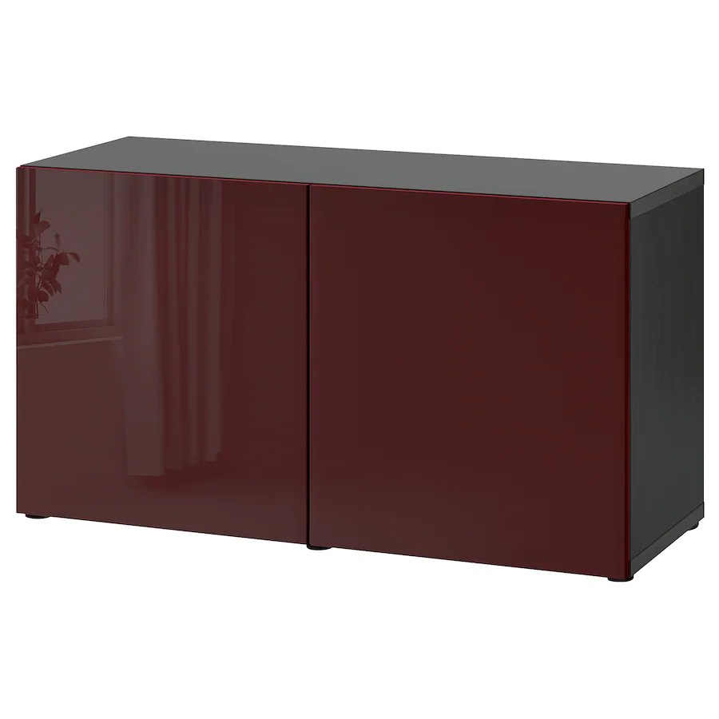
2. What is this?¹
MÝRIN
BESTÅ
¹I will stop using google translate for the titles in case anyone corrects my translation

Slide 5
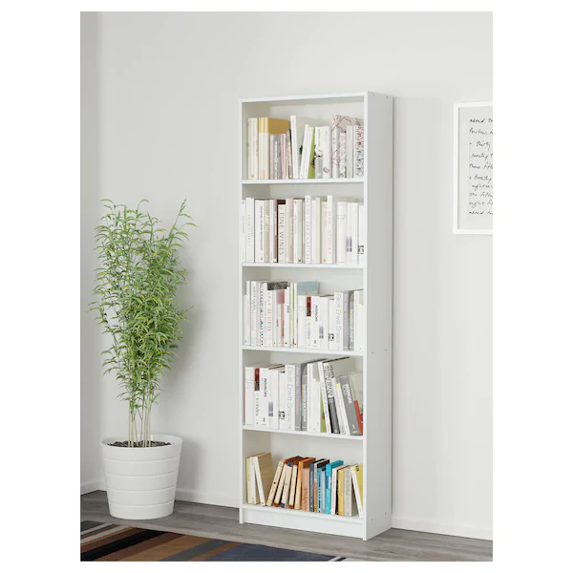
3. What are these?
THELMA
GERSBY

Slide 6
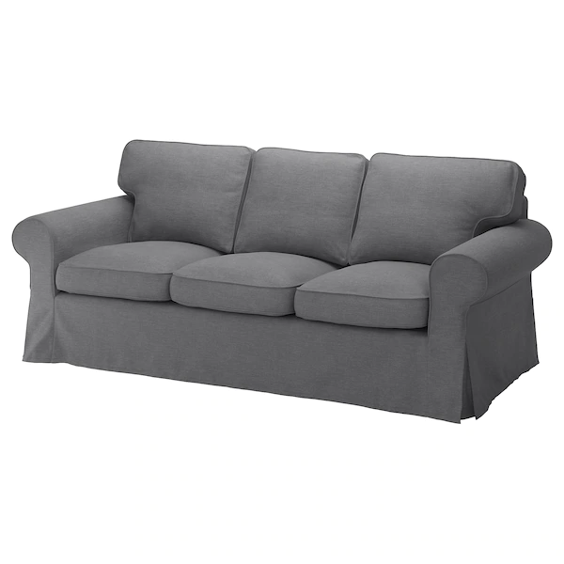
4. What is this?
Ektorp
Sønner

Slide 7
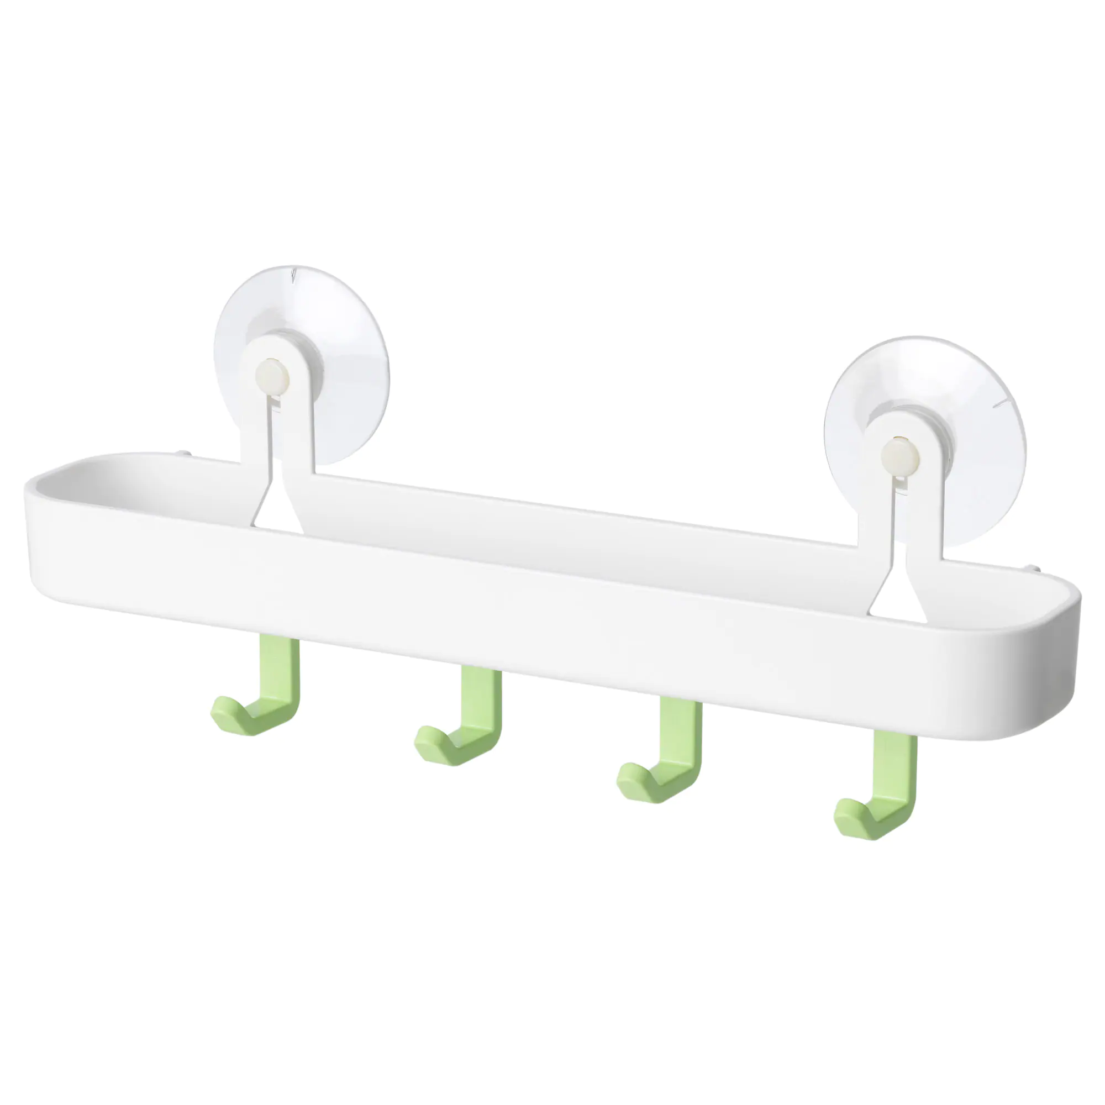
5. What line do these belong to?
GLÖMSTA
VINTERBRØDRE

Slide 8
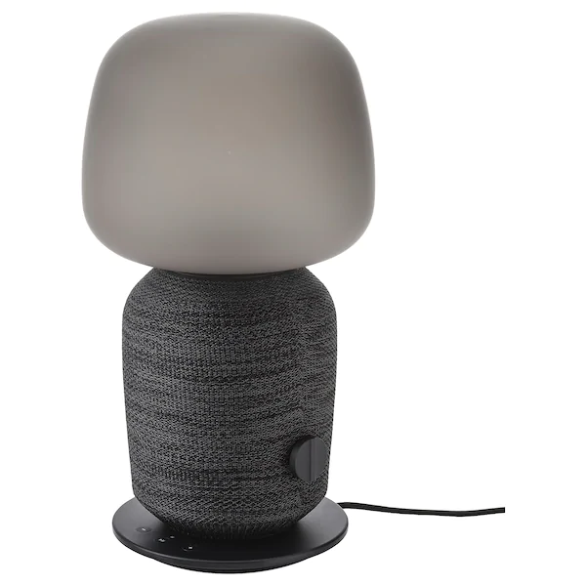
6. What is this?
SYMFONISK
KORPARNA

Slide 9

7. What line do these belong to?
BAGIS
OKAY

Slide 10
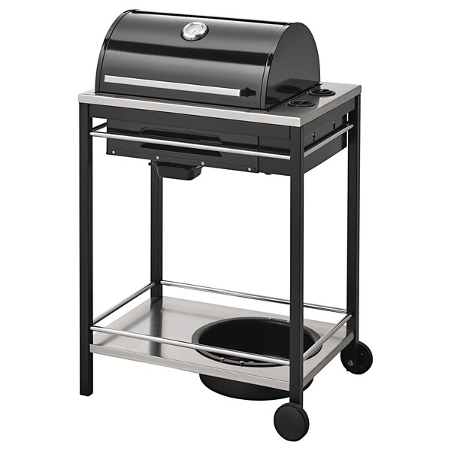
8. What is this? (hint: 2005 winner)
DRABET
KLASEN

Slide 11
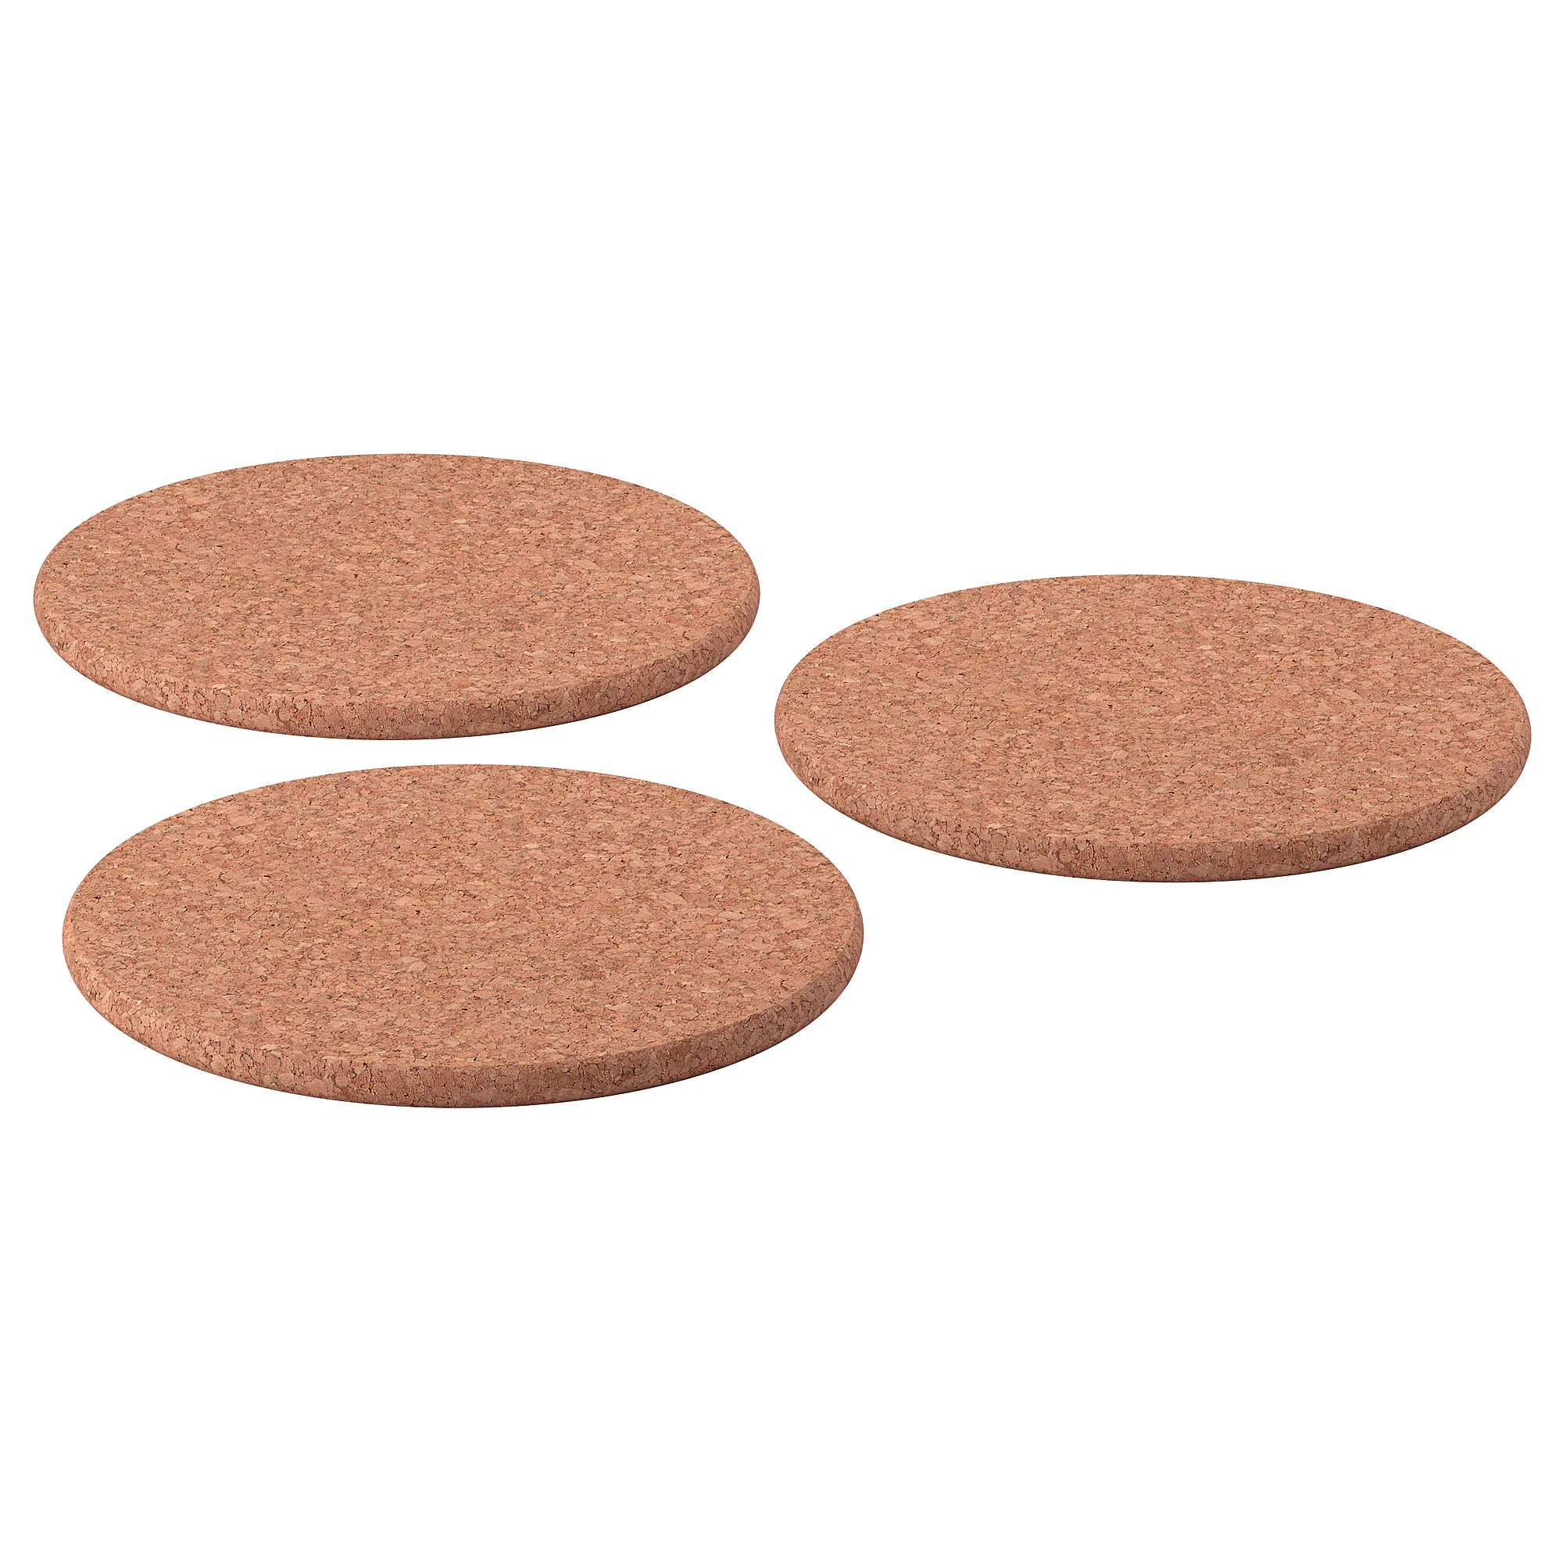
9. What line do these belong to?
SAUNA
HEAT

Slide 12
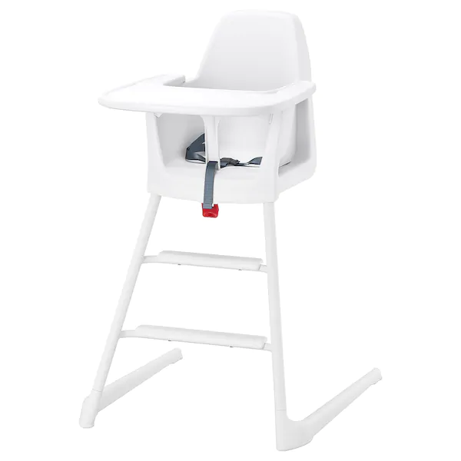
10. What is this?
LANGUR
LJUSÅR

Slide 13
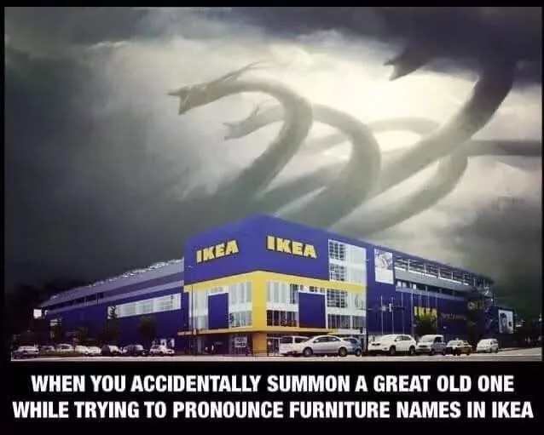
Answers

Slide 14
1. What are these?
Lill
Blindsone
English – Blind spot
2019 Nominee

Slide 15
2. What is this?
Mýrin
English – Jar City
Nominated 2007
BESTÅ

Slide 16
3. What is this?
THELMA
Same in English
Nominated 2018
GERSBY

Slide 17
4. What is this?
Ektorp
Sønner
English – Sons
Nominated 2007

Slide 18
5. What line do these belong to?
GLÖMSTA
VINTERBRØDRE
English – Winter Brothers Nominated 2018

Slide 19
6. What is this?
SYMFONISK
KORPARNA
English – Ravens
Nominated 2018

Slide 20
7. What line do these belong to?
BAGIS
OKAY
English – OKAY
Nominated 2002

Slide 21
8. What is this? (hint: 2005 winner)
DRABET
English – Manslaughter
Winner 2005
KLASEN

Slide 22
9. What line do these belong to?
SAUNA
English – Sauna
2009 Runner up
HEAT

Slide 23
10. What is this?
LANGUR
LJUSÅR
English – Light year
Nominated 2009

